Slide 1
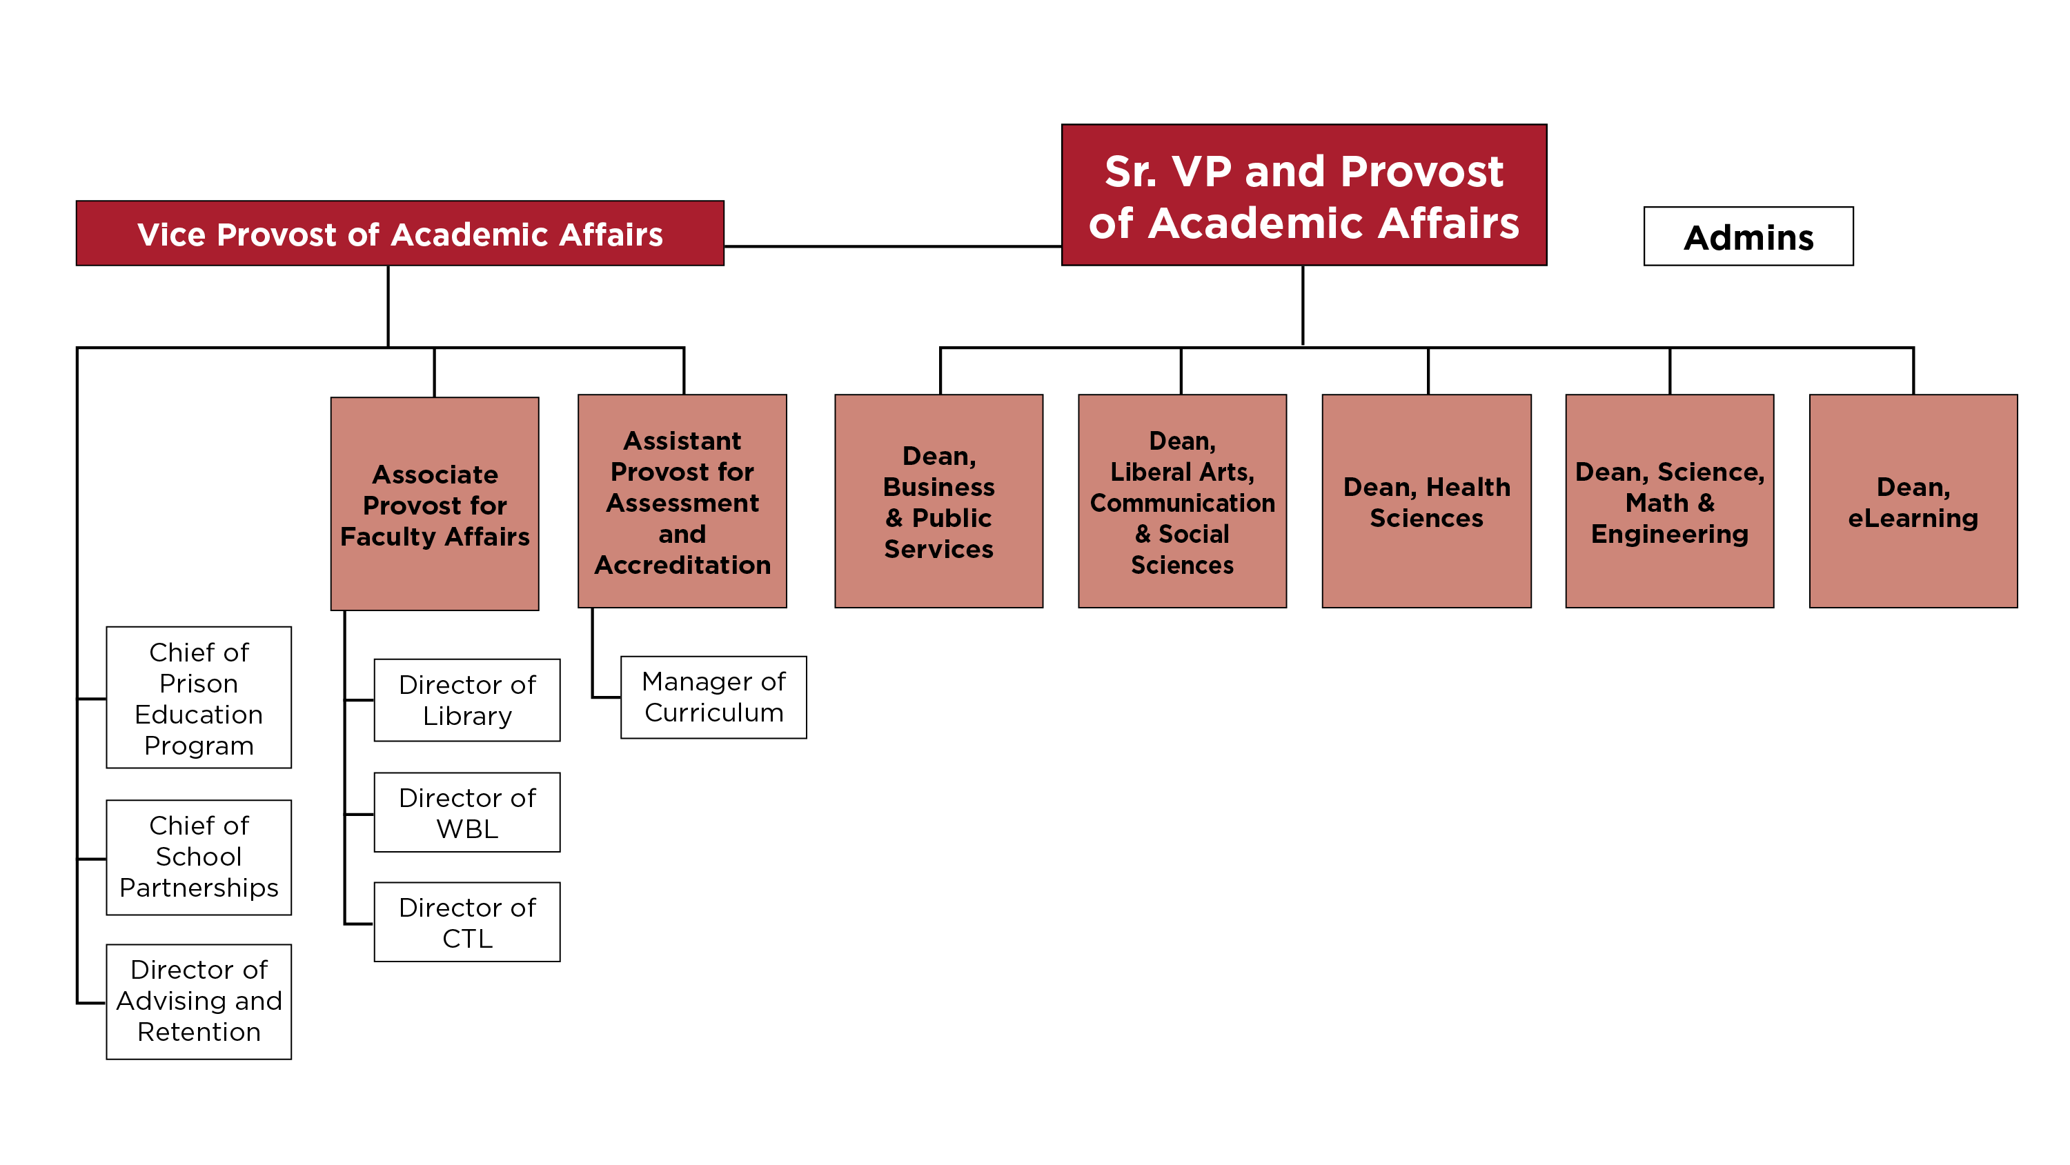
Academic Affairs LT Structure

