Slide 1
2024 SSS Annual academic celebration
Honoring our Graduates and Other Achievers of 2023-24

Slide 2
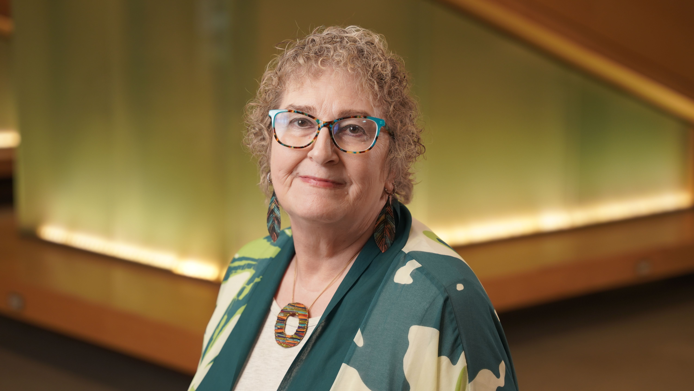
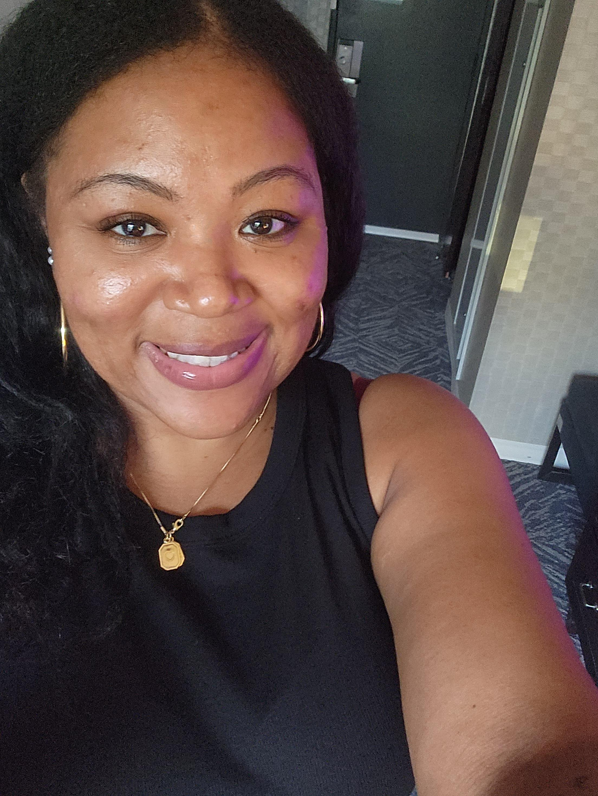
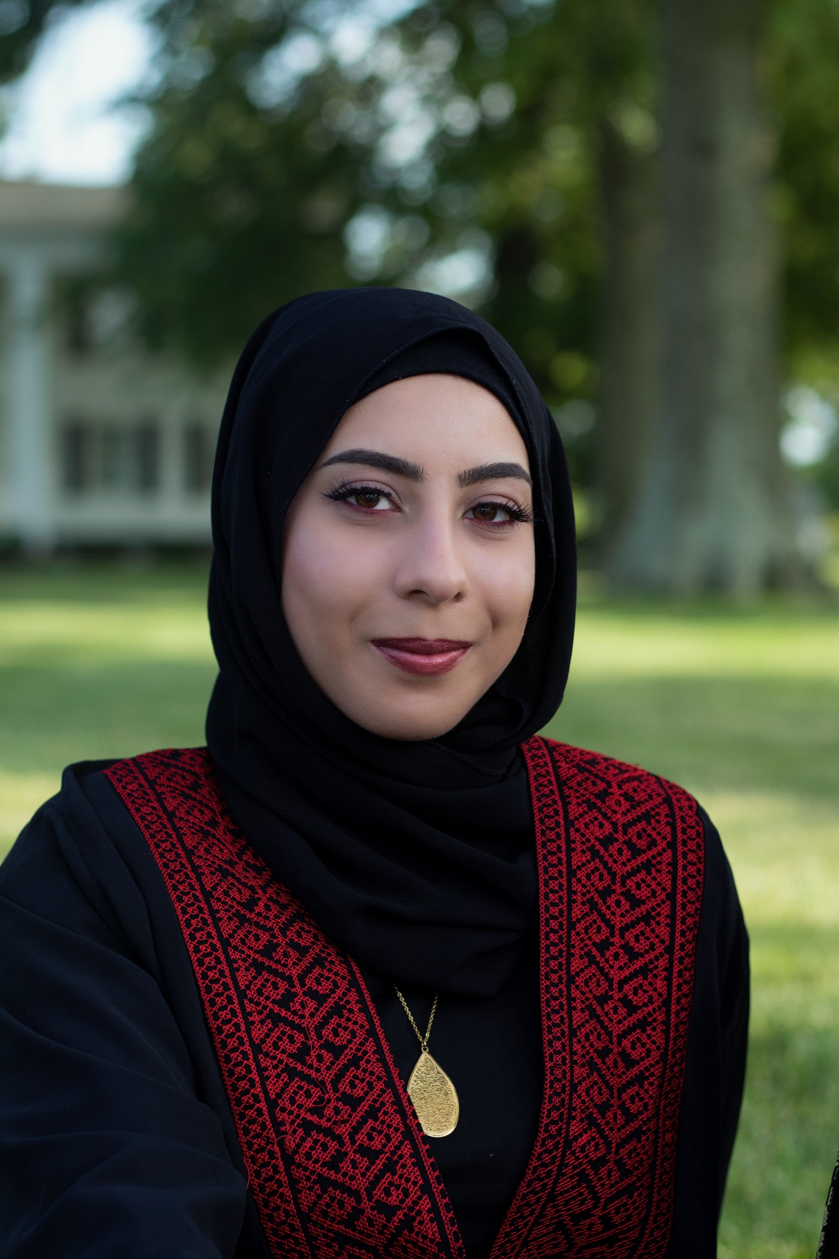
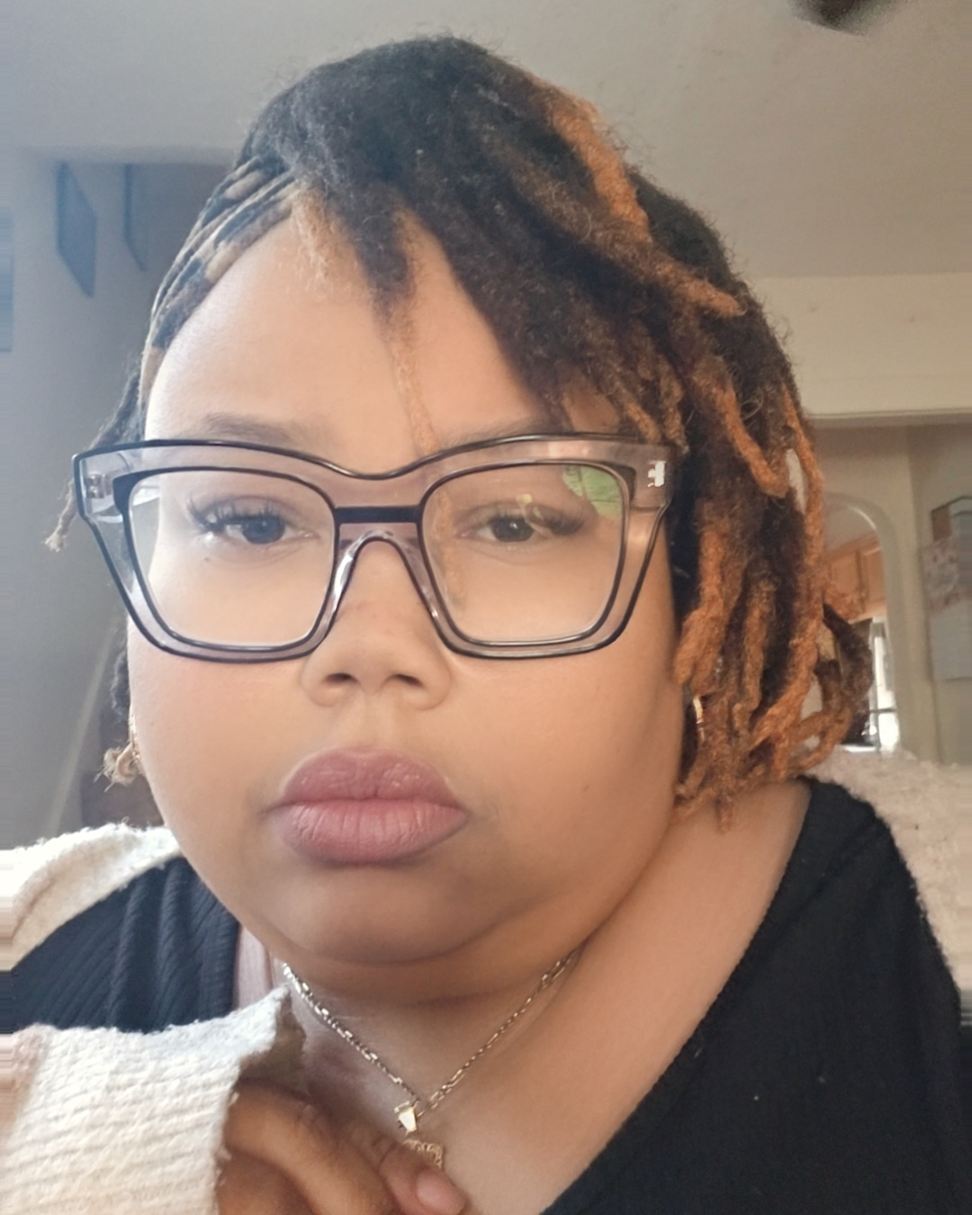
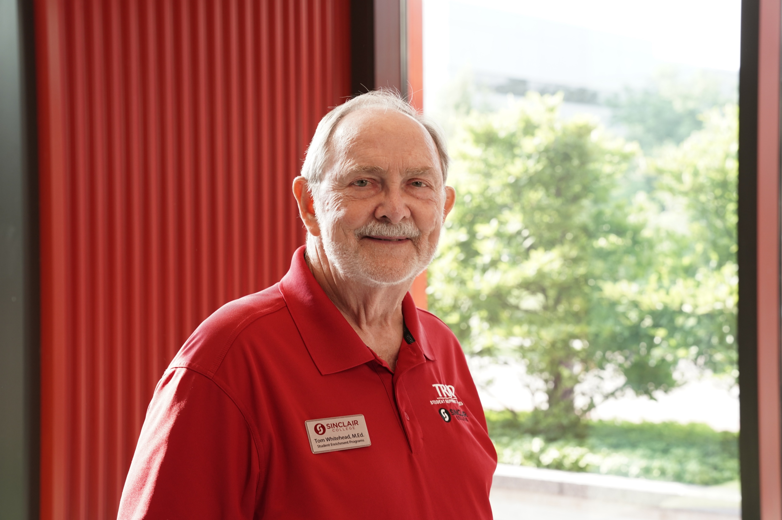
A special welcome from the sss Staff
Ms. Carmel
Ms. Simone
Ms. Cynthia
Mr. Tom
Ms. India
Mrs. Zubeida

Slide 3
Academic persistence Award
for Math

Slide 4
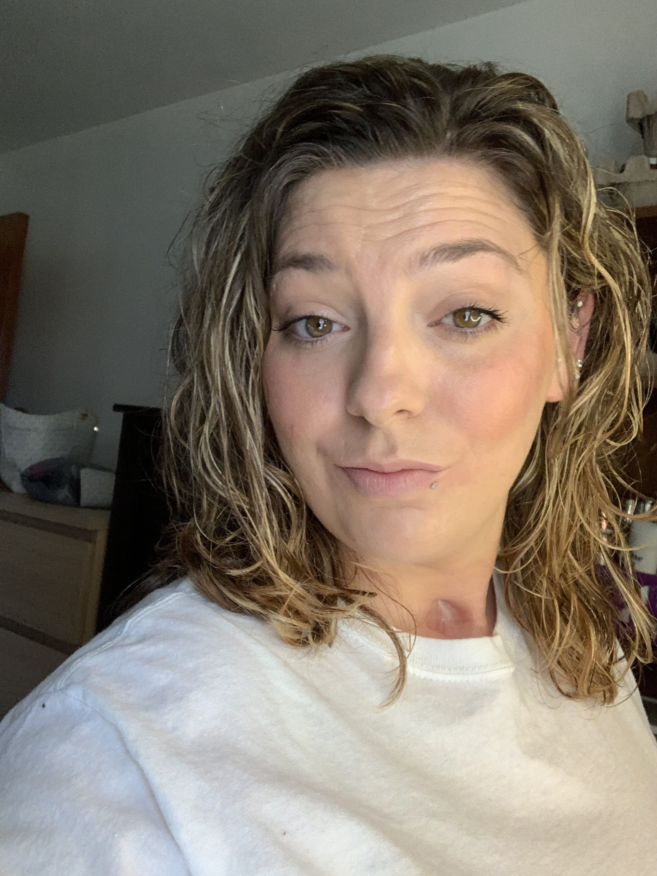
Victoria Harkleroad
This award is for setting small, achievable goals, seeking help when needed, and practicing regularly.

Slide 5
Academic persistence Award
for Science

Slide 6
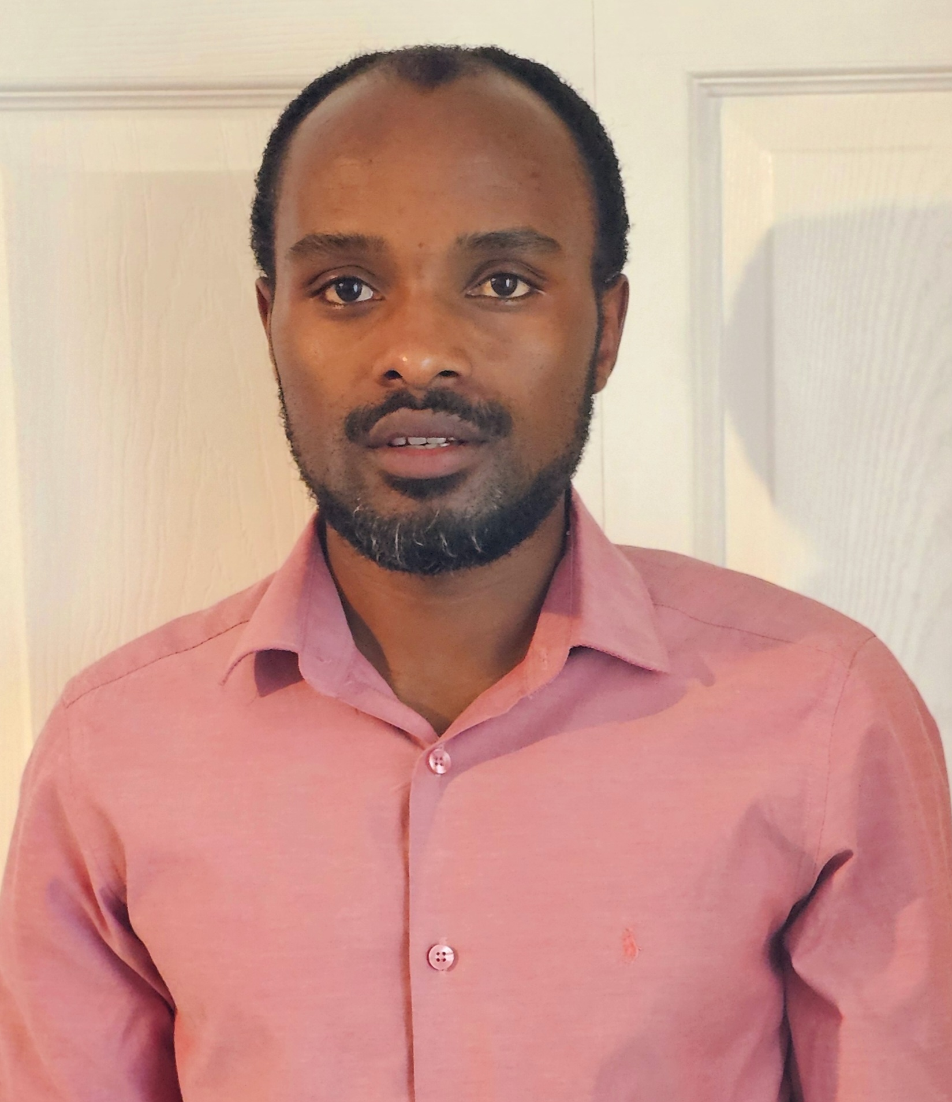
Theoneste Nshimiyimana
This award is for setting small, achievable goals, seeking help when needed, and practicing regularly.

Slide 7
Academic persistence Award
for English

Slide 8
Jean Claude Niyibizi
This award is for overcoming language barriers to perform in English through diligent use of tutoring services in SSS.

Slide 9
Academic persistence Award
for Social Sciences

Slide 10
Ramadan Adem
This award is for embracing a growth mindset, being resilient in the face of challenges, and staying dedicated to your academic journey.

Slide 11
Superlative Awards

Slide 12
Jordan Young “Most Helpful Student”
Your willingness to lend a helping hand, offer support, and make a positive impact sets you apart as a shining example of excellence and good character.

Slide 13
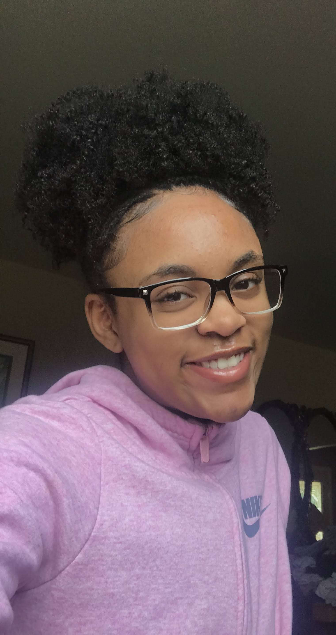
Christina Jones “Most Active Student”
You serve as an inspiration to your peers, encouraging others to pursue their interests, explore new opportunities, and make the most of their educational experience.

Slide 14
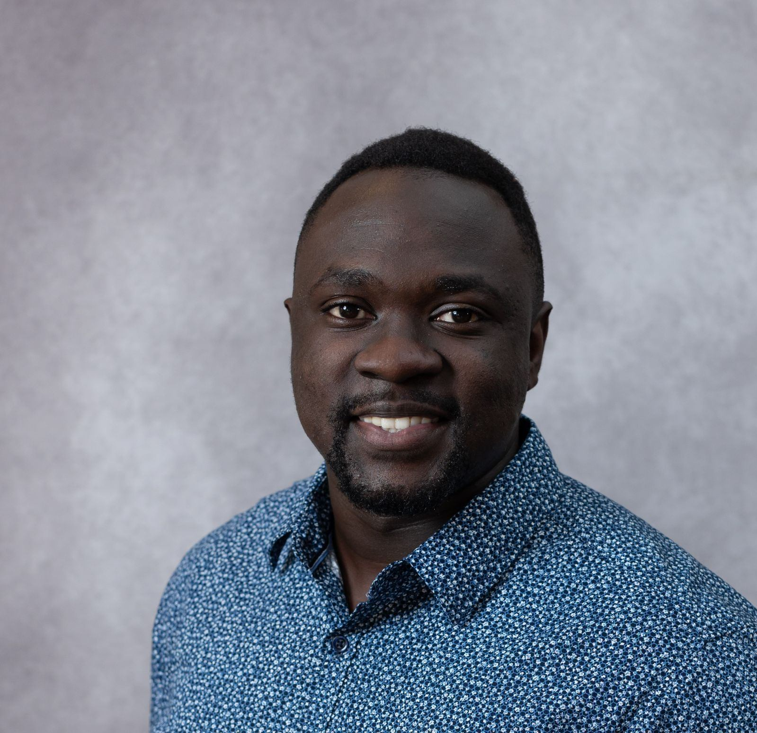
Colin Kimuli “Most social-on-social media”
Your ability to connect with others, share meaningful content, and foster a sense of community is truly inspiring.

Slide 15
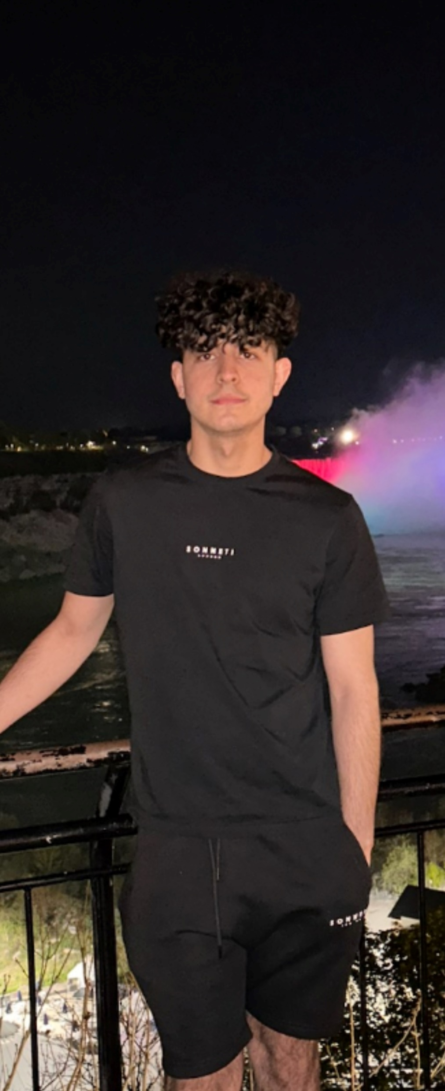
Francine Murekatete (not pictured) & Abdulrahman Ghentawi “ Most tutored students”
Your willingness to ask questions, seek help, and never giving up truly sets you apart.
For always seeking assistance from instructors and tutors, your hard work and determination paid off.

Slide 16
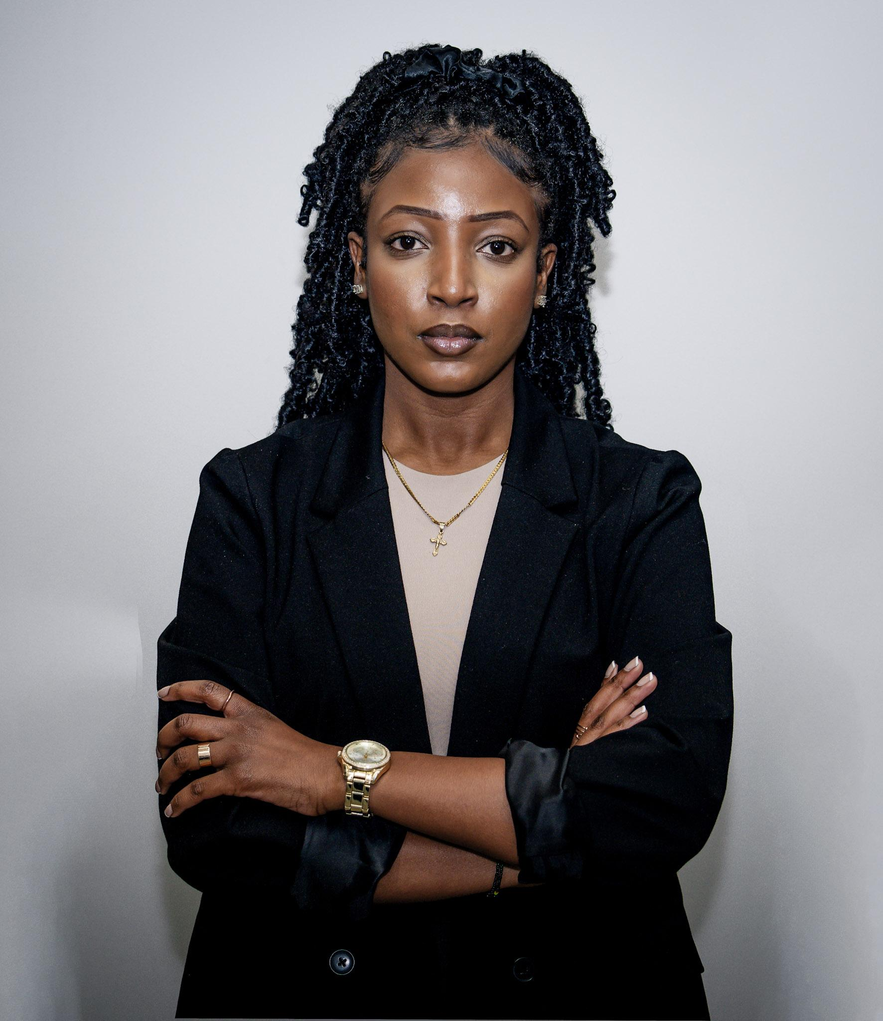
Fabiola Uwineza “ Most Active TRiO Alum”
This award celebrates your continued involvement in supporting and uplifting current TRIO students, as well as their efforts to give back and make a positive impact.

Slide 17
Students earning certificates

Slide 18
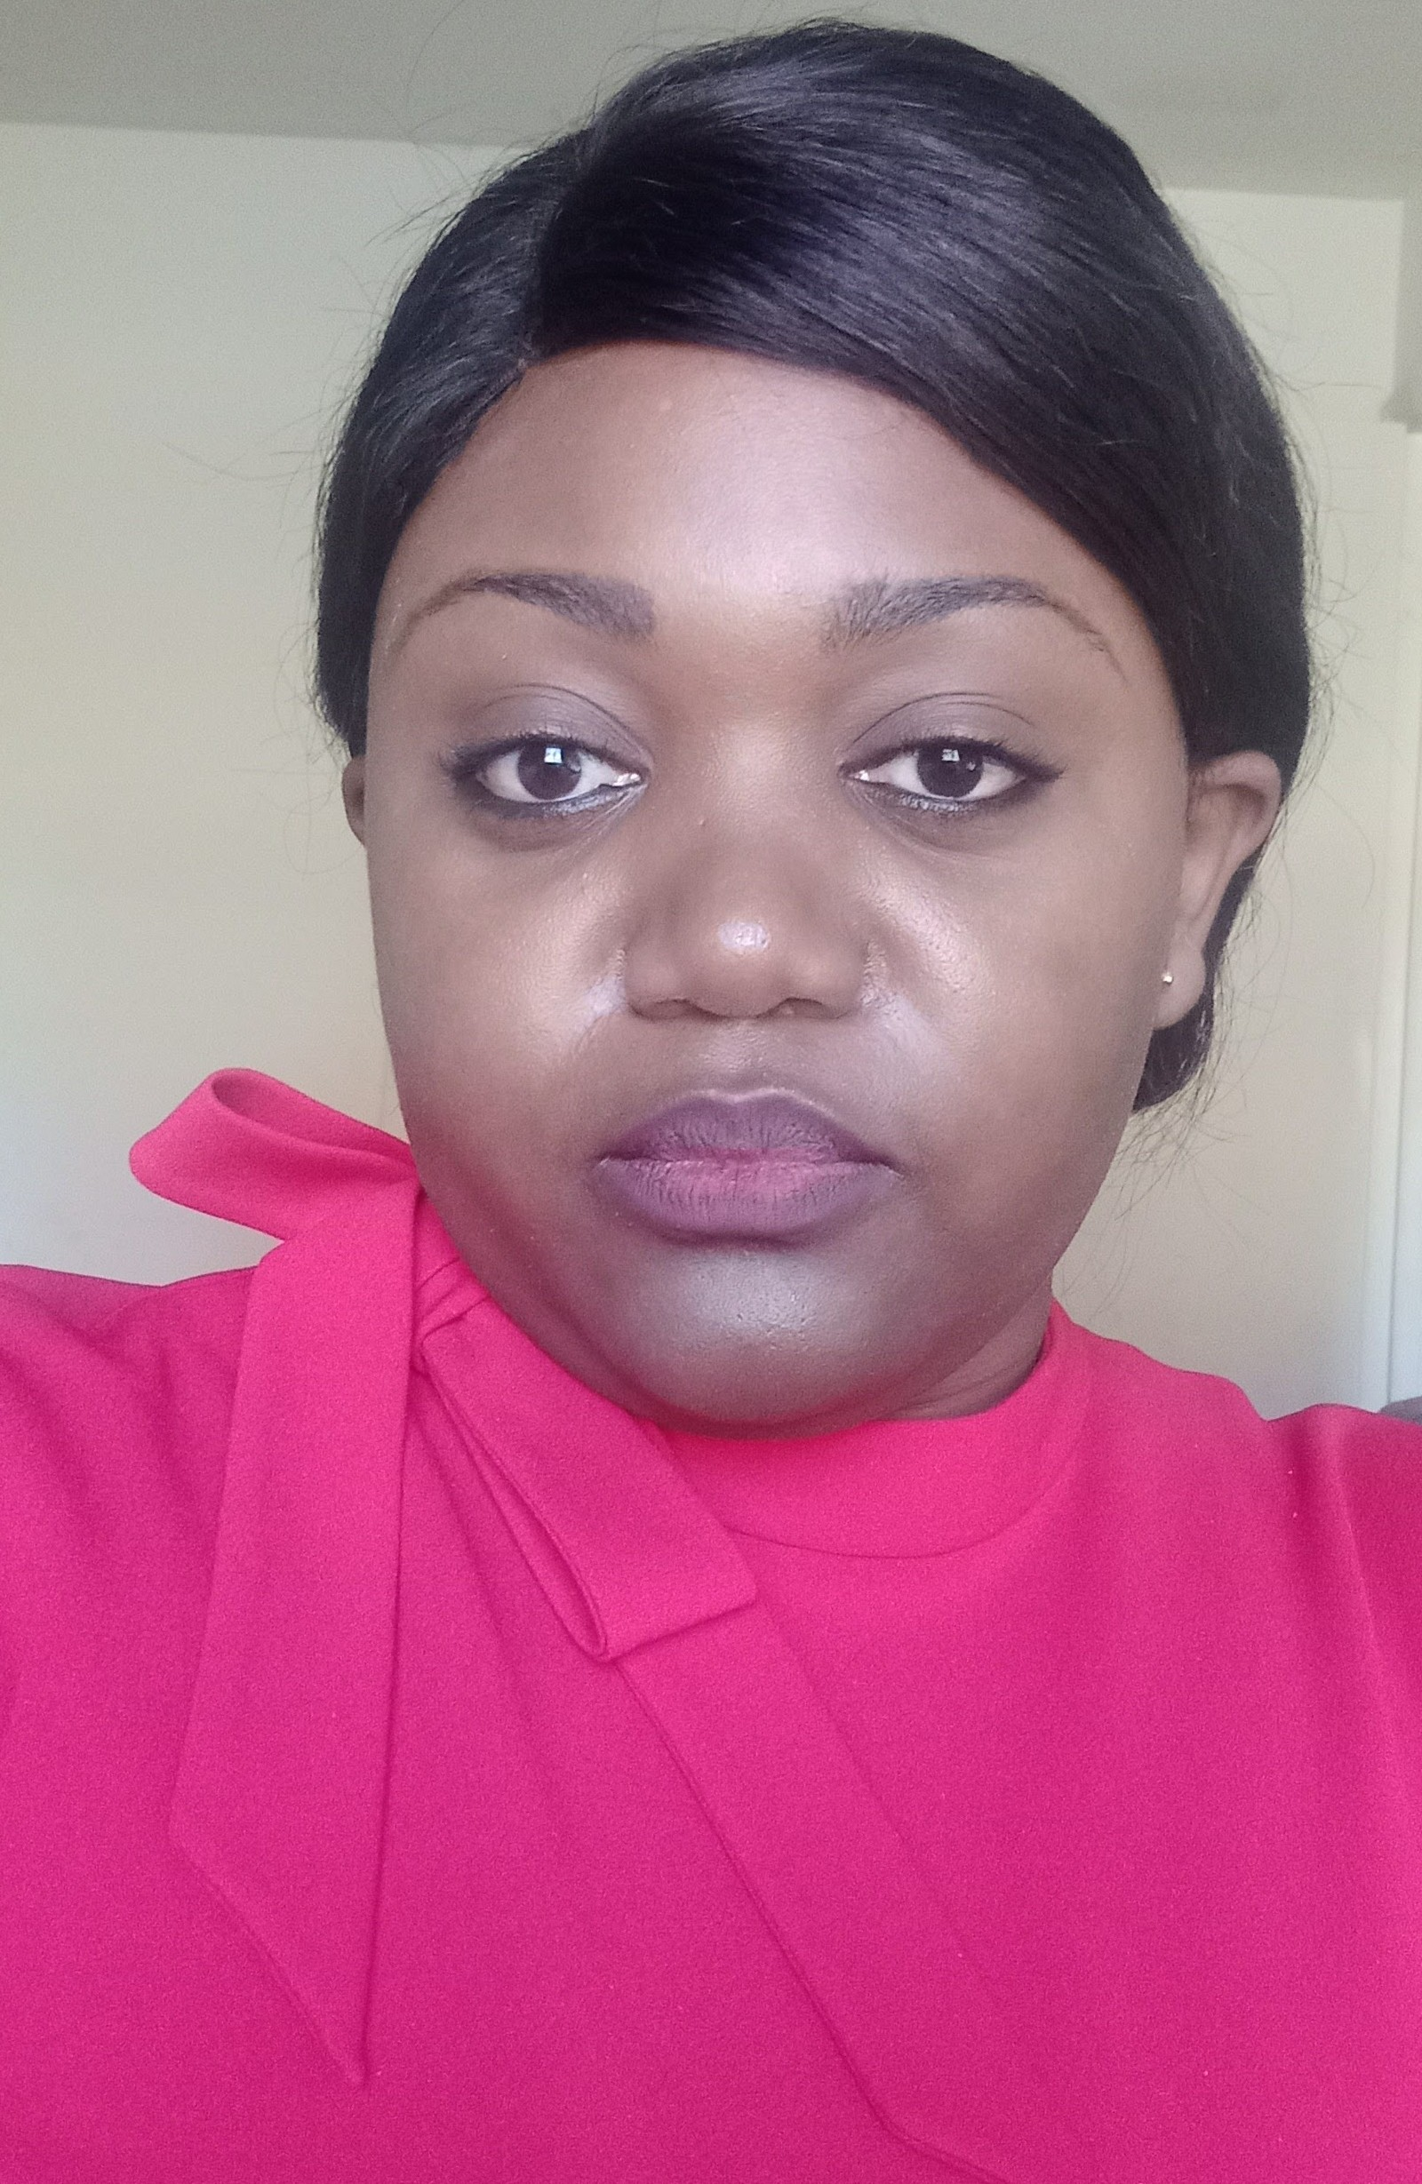
Dany Anago
Certificate - IT Fundamentals ITFN.S.STC

Slide 19
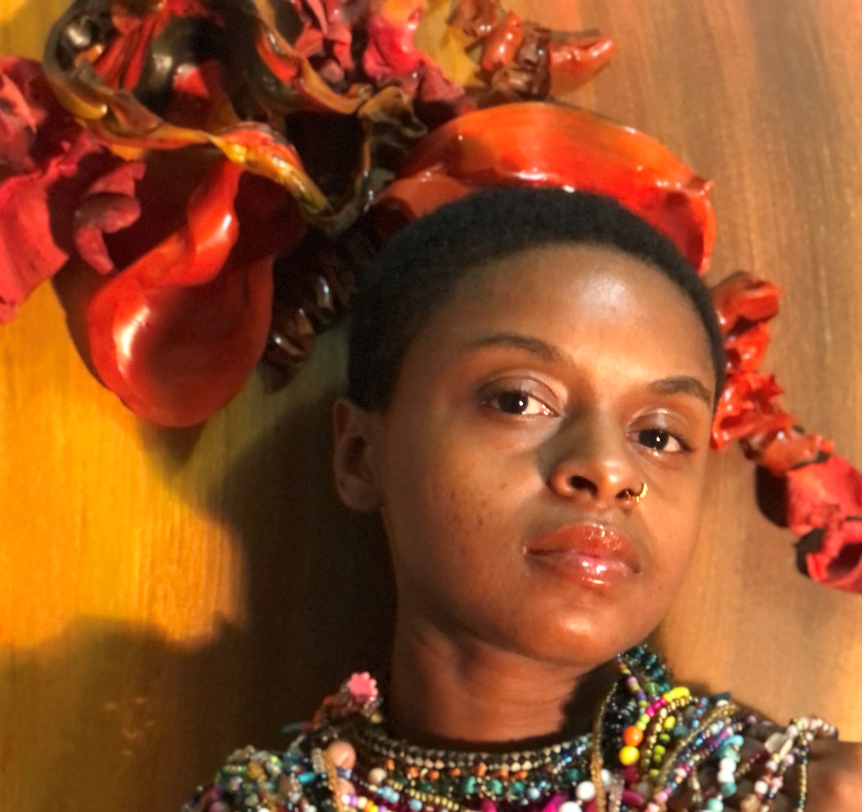
Lachrisa Gales
Certificate - Design Processes VISDP.S.STC

Slide 20
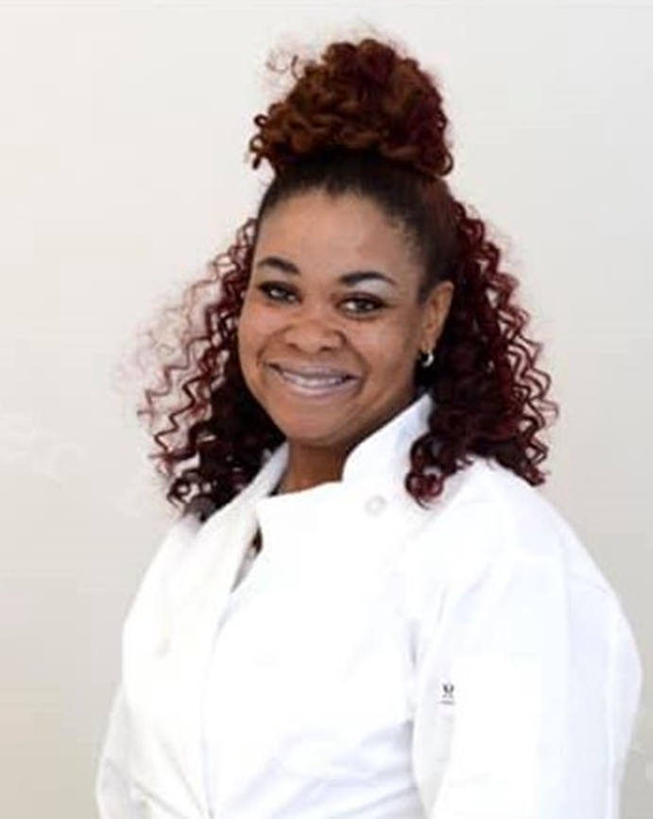
April Harris
Certificate - Clinical Phlebotomy CPST.S.STC

Slide 21
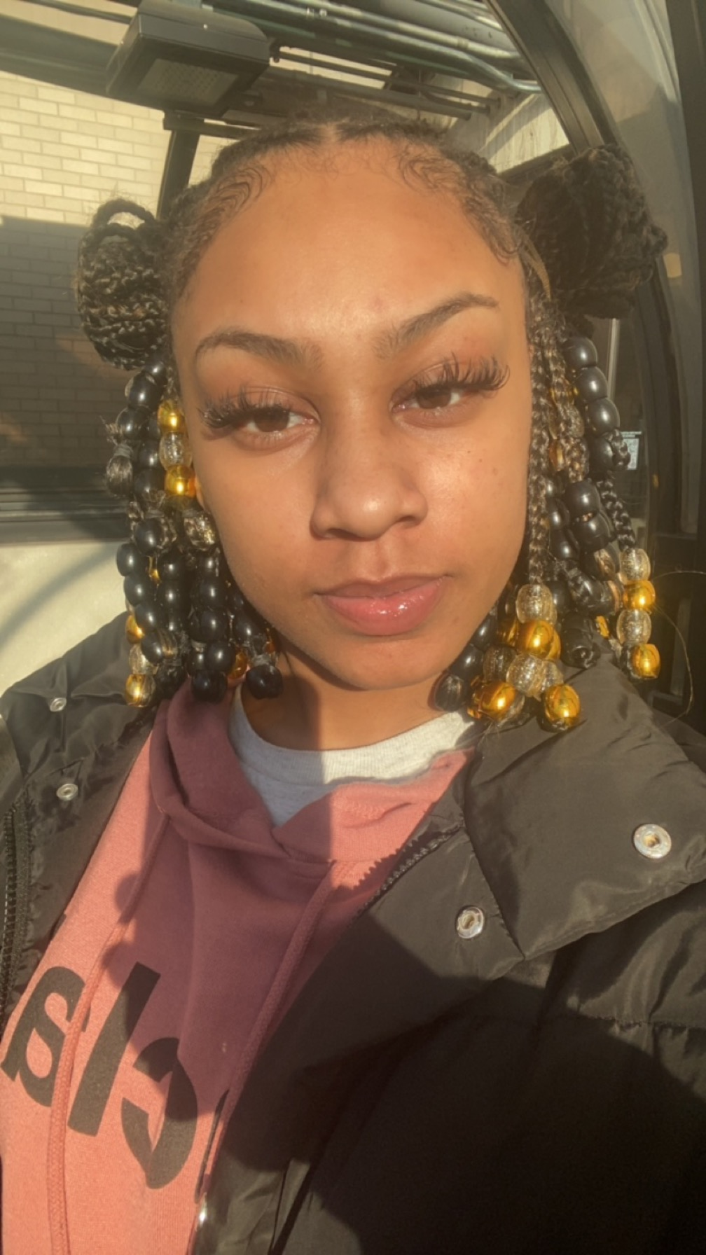
Ahmeenah Hasan
Certificate - Business Management BM.S.CRT

Slide 22
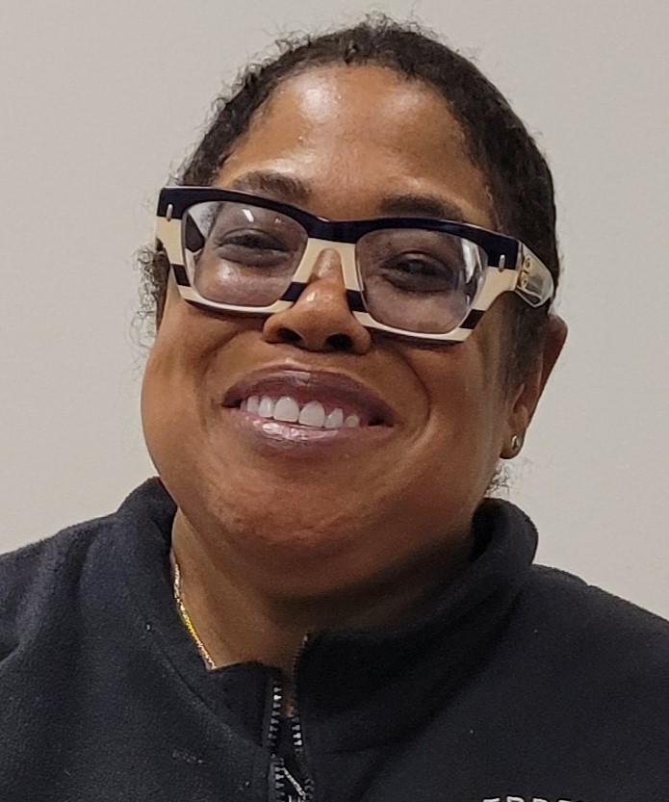
Marcia Passmore
Certificate - Chemical Dependency Counselor Assistant CDCA.S.STC

Slide 23
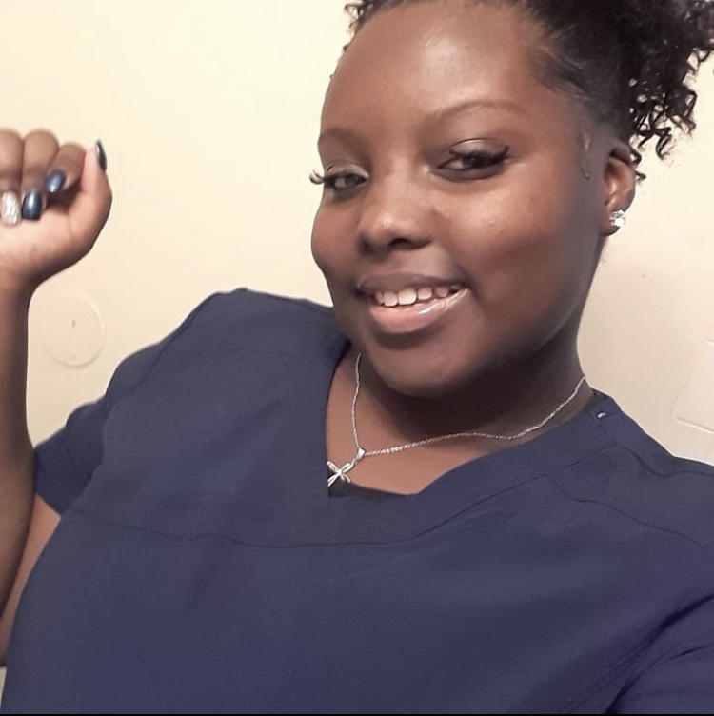
Ranasia Sims
Certificate – Nurse Aide NAST.S.STC

Slide 24
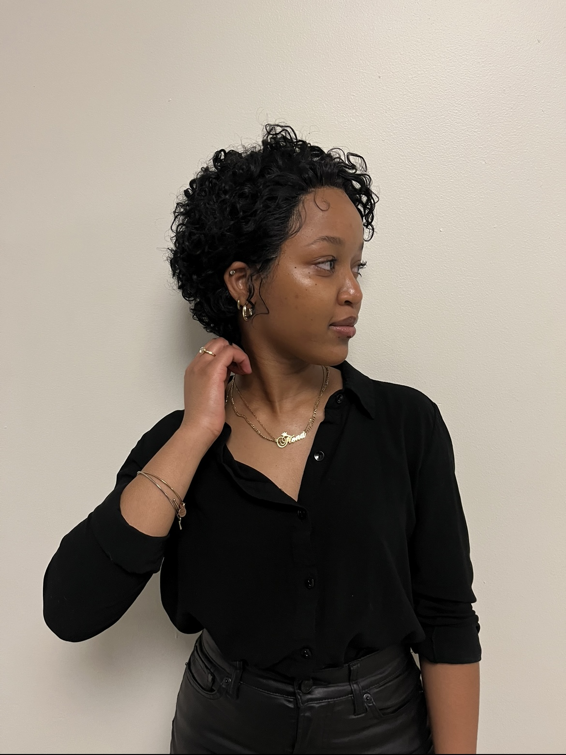
Fiona Uwumugisha
Certificate - Design Processes VISDP.S.STC

Slide 25
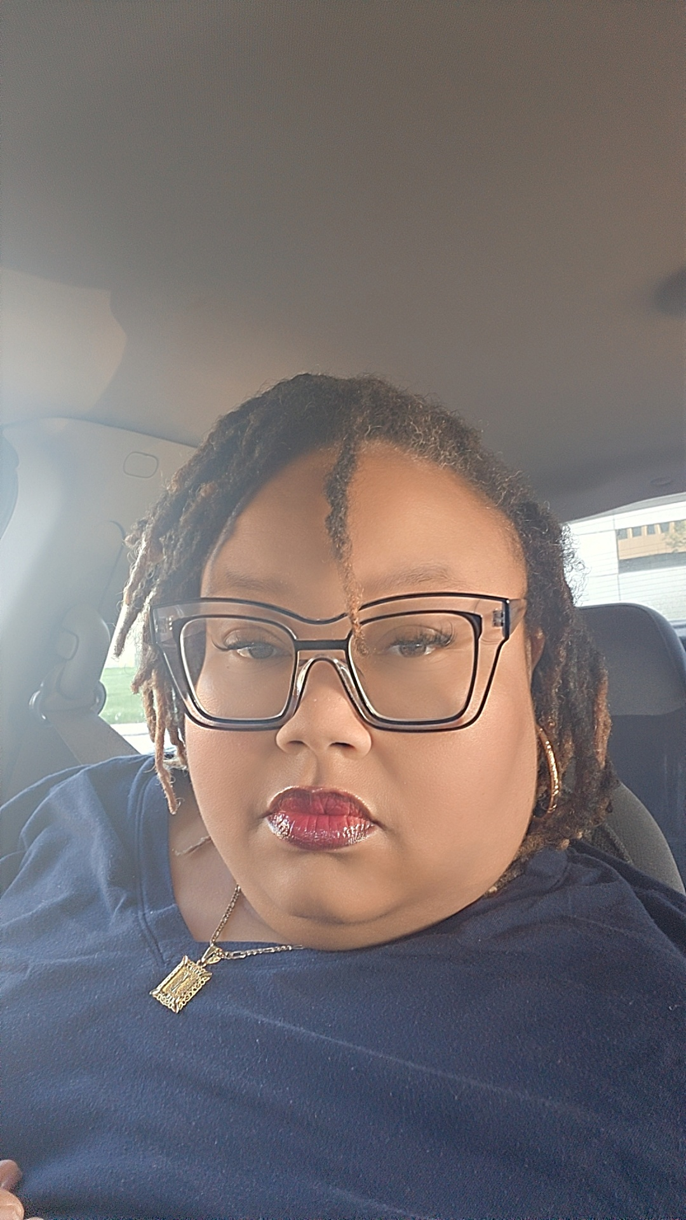
India White
Certificate –
RETAIL BUSINESS RTB.S.STC
SMALL BUSINESS MANAGEMENT SBM.S.STC

Slide 26
Additional Certificate Earners

Slide 27
Additional Certificate Earners – 2023-24
Ariete Ayinkamiye
Clinical Phlebotomy CPST.S.STC
Michael Gibson
Chemical Dependency Counselor Assistant (CDCA) Preliminary CDCA.S.STC
Samantha Luckenbill
Social Service SOCS.S.STC
Lashell Pryor
Health Information Management Technician HIMT.S.CRT

Slide 28
Students earning Associate degrees

Slide 29
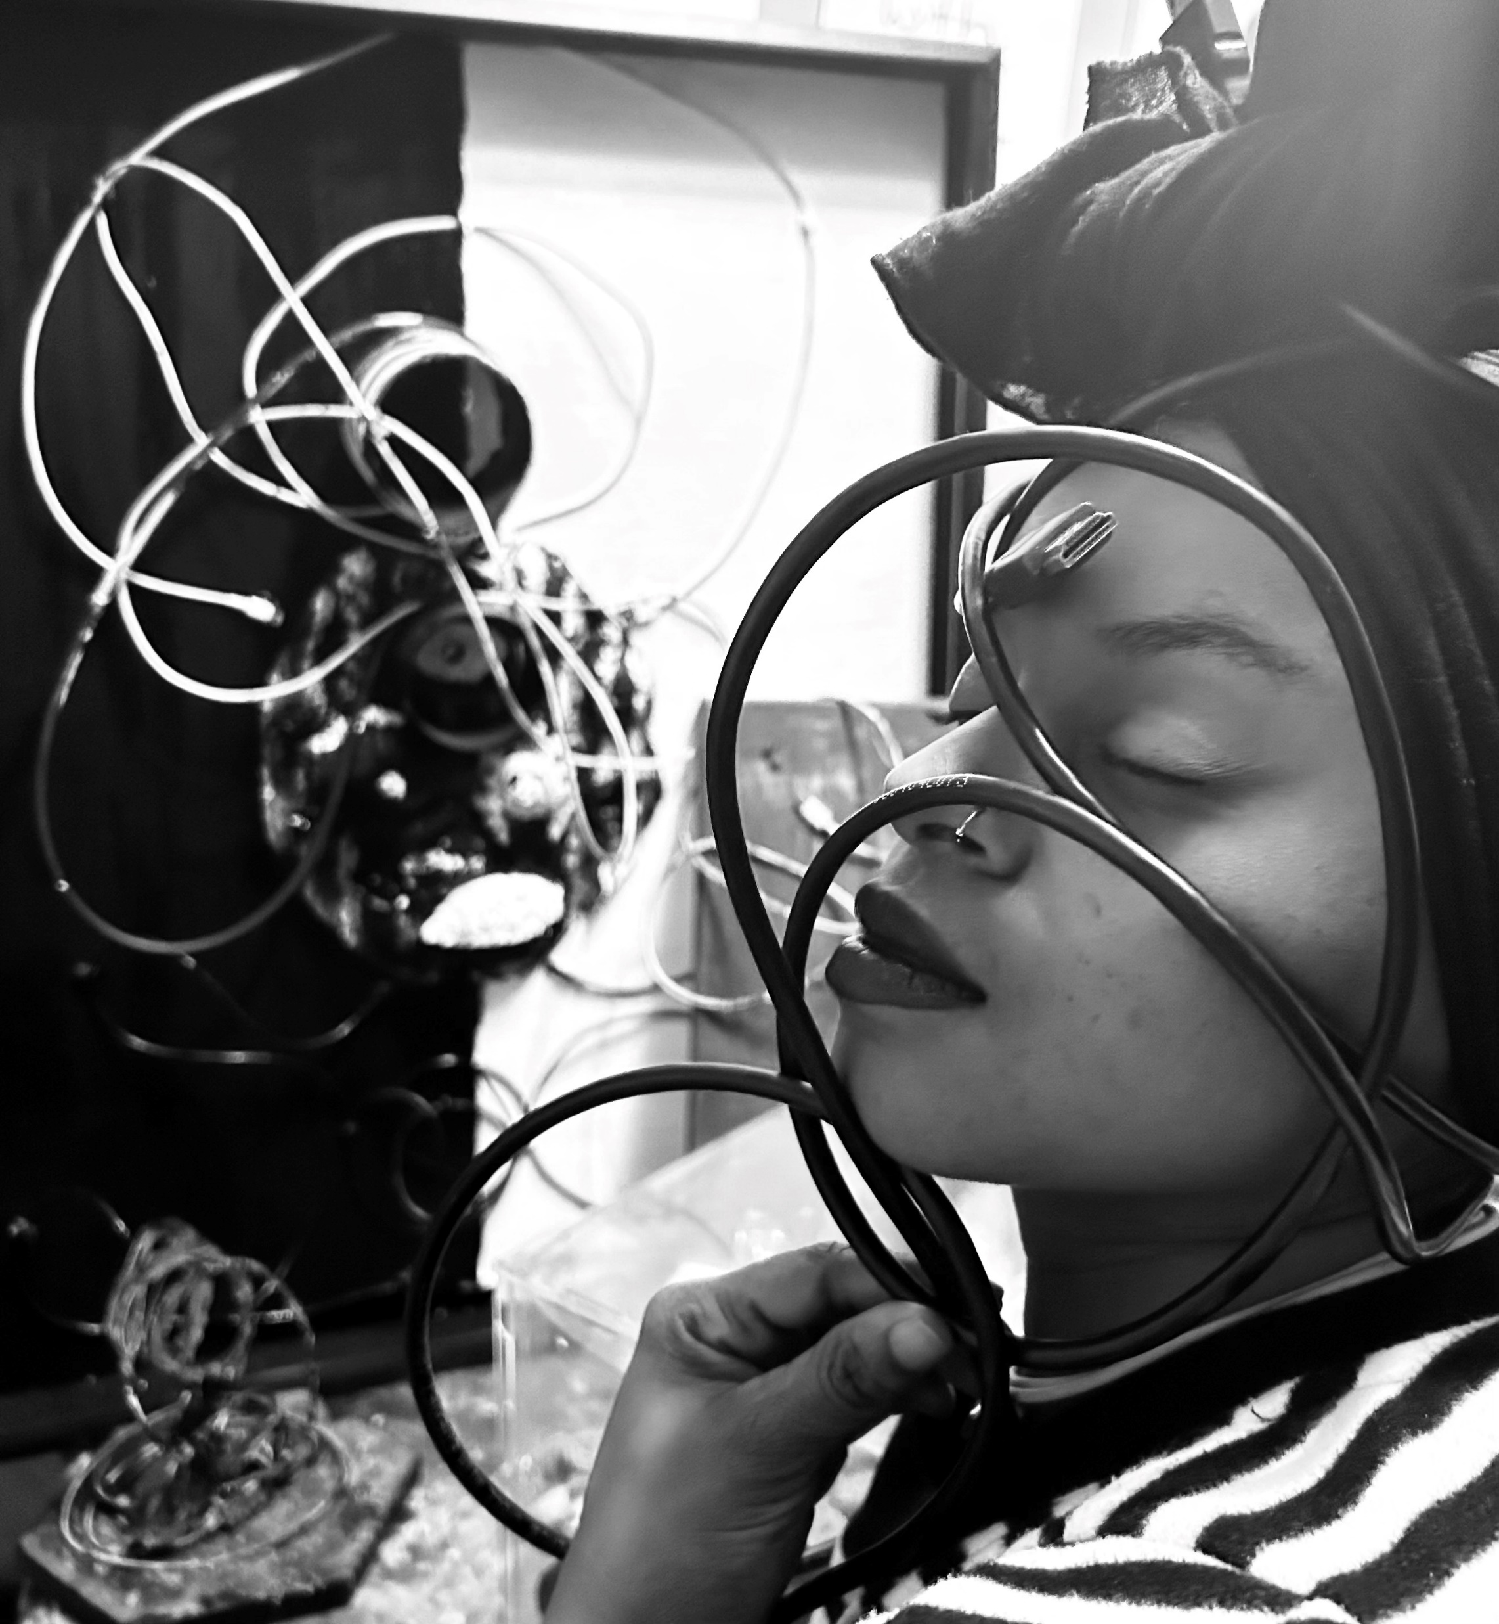
Lachrisa Gales
Program: Associate of Applied Science Interior Design (IND.S.AAS)
Lachrisa’s goal is to own and operate a design firm ( LJG Designs) where she will specialize in color consulting and exhibit design for galleries and museums.
Favorite quote: “Nothing beats a failure but a try. If I am trying, I cannot fail."
-Linda Gales
Motto: Paint Molds Art.

Slide 30
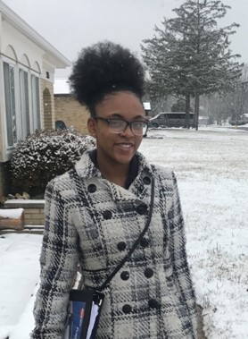
Christina Jones
Program: Associate of Applied Science Health Sciences (HS.S.AAS)
Christina plans to continue her academic career here at Sinclair to pursue Nursing. She looks forward to seeing what God has in store for her.
Favorite quote: “You can do anything you set your mind to, but it takes action, perseverance, and facing your fears.”
-Gillian Anderson

Slide 31
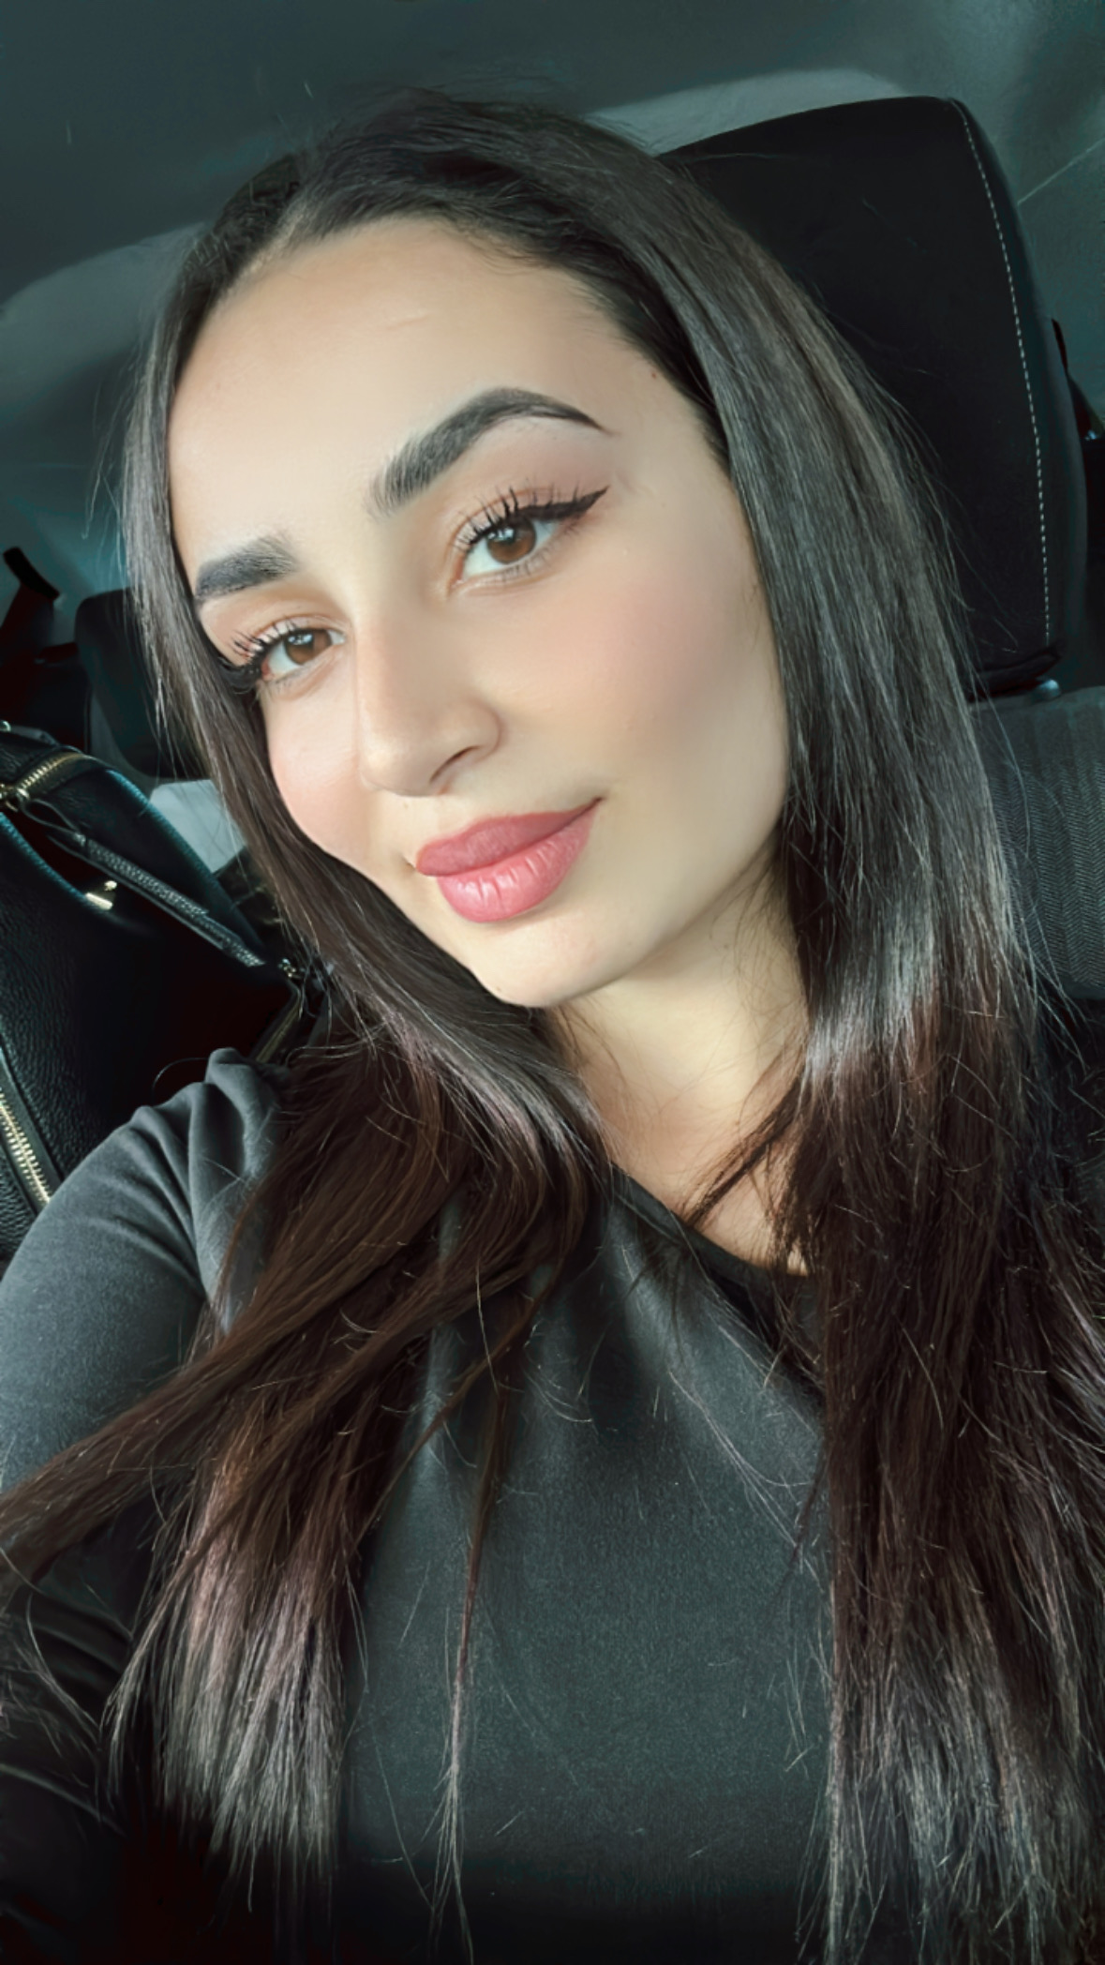
Madina Lutfiyeva
Program: Associate of Science Liberal Arts (LA.S.AS)
Madina is grateful to her parents for giving her the opportunity at such a young age to experience the American dream and now she can't wait for her dream career.

Slide 32
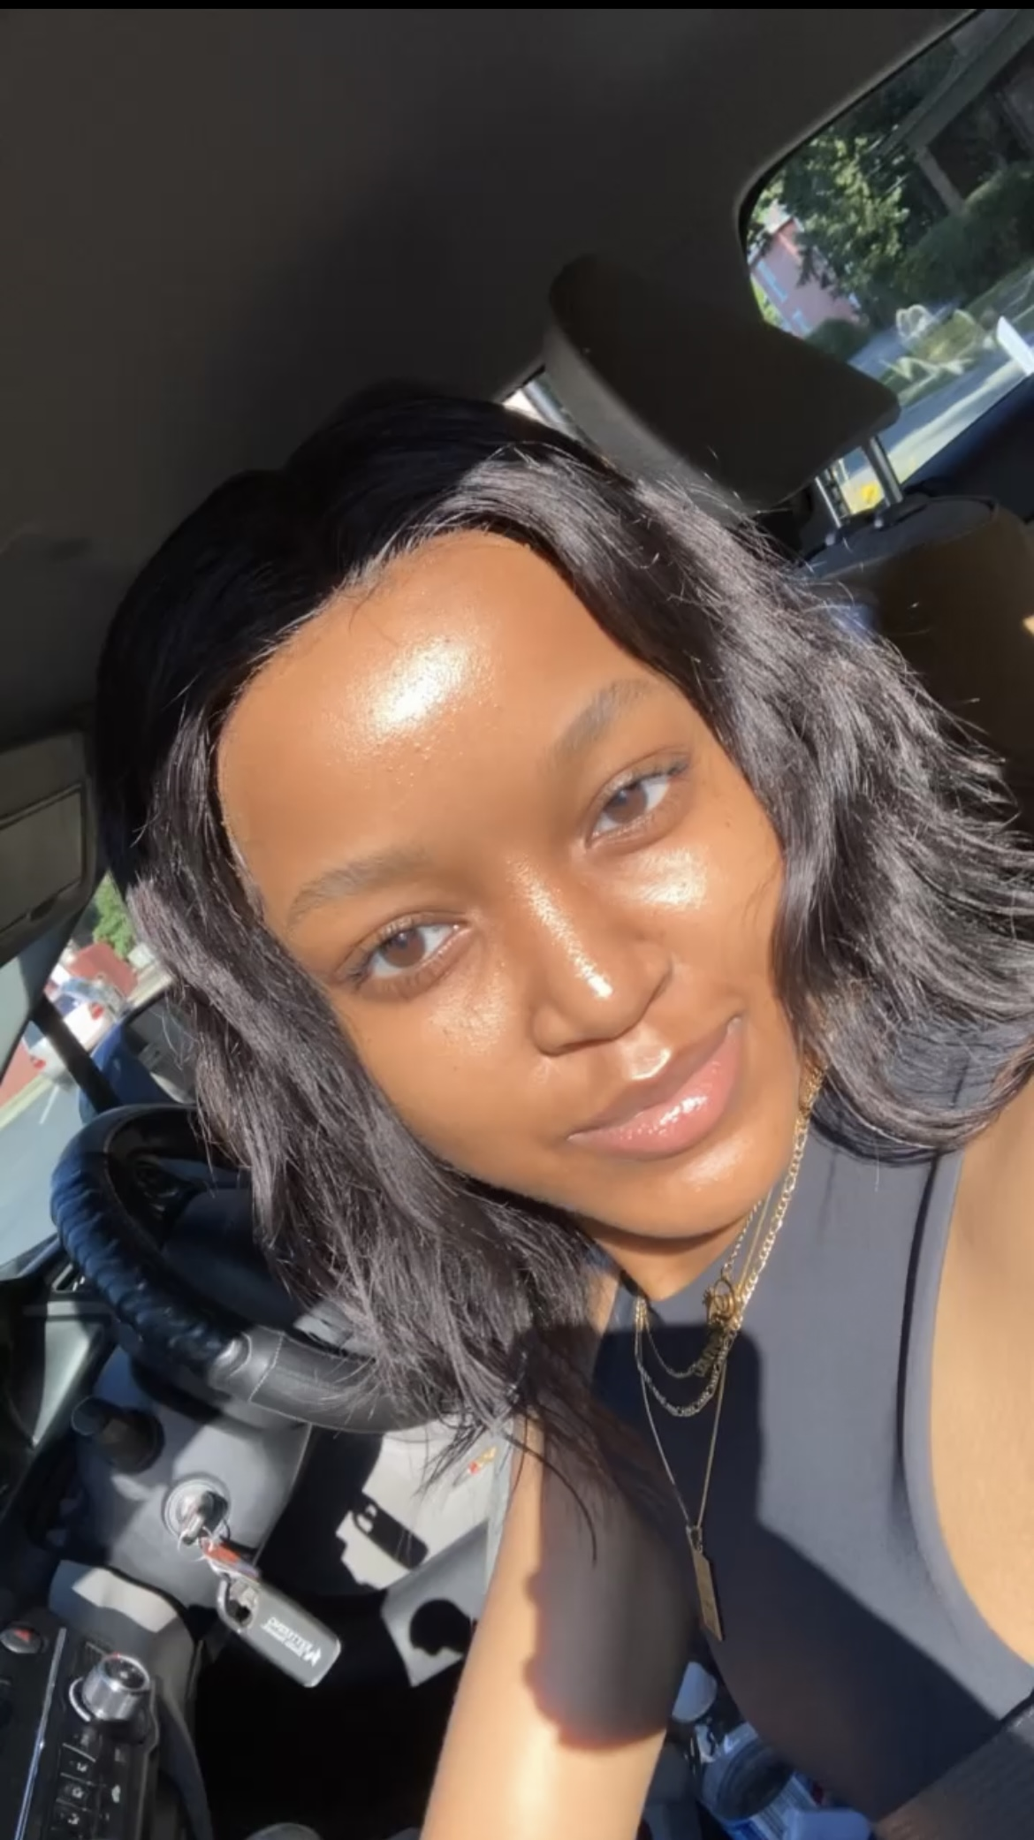
Fiona Uwumugisha
Program: Associate of Applied Science Interior Design (IND.S.AAS)
Fiona is prepared to make a lasting impact in the world of design, leaving her mark on spaces and hearts alike.
Favorite quote: “You cannot do all the good the world needs, but the world needs all the good that you can do."
Motto: Stay grateful

Slide 33
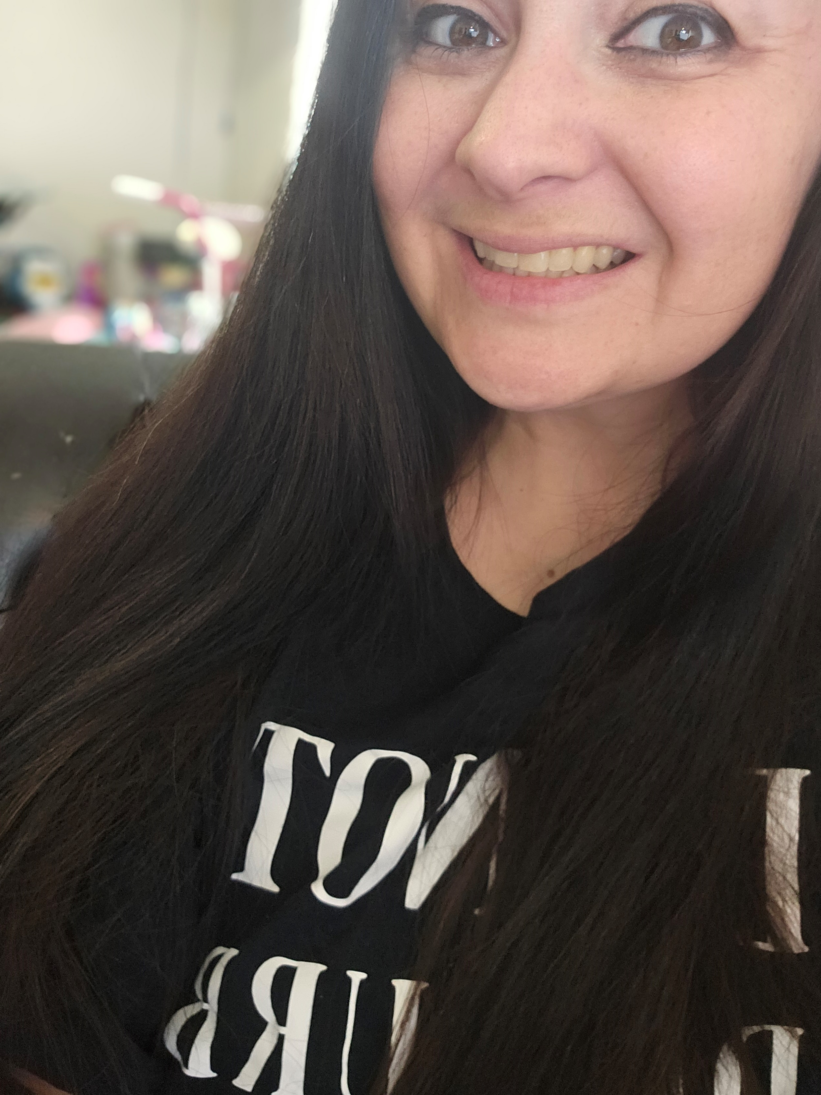
Samantha Luckenbill
Program: Associate of Arts Social Work (SWKE.S.AA)
Samantha is a proud mother of three beautiful girls and with hard work and persistence she has reached her goal of obtaining her Associate degree.
Favorite quote: “Hard work pays off.”
Motto: Never give up, keep going, crawl if you must but eventually you will achieve all your goals.

Slide 34
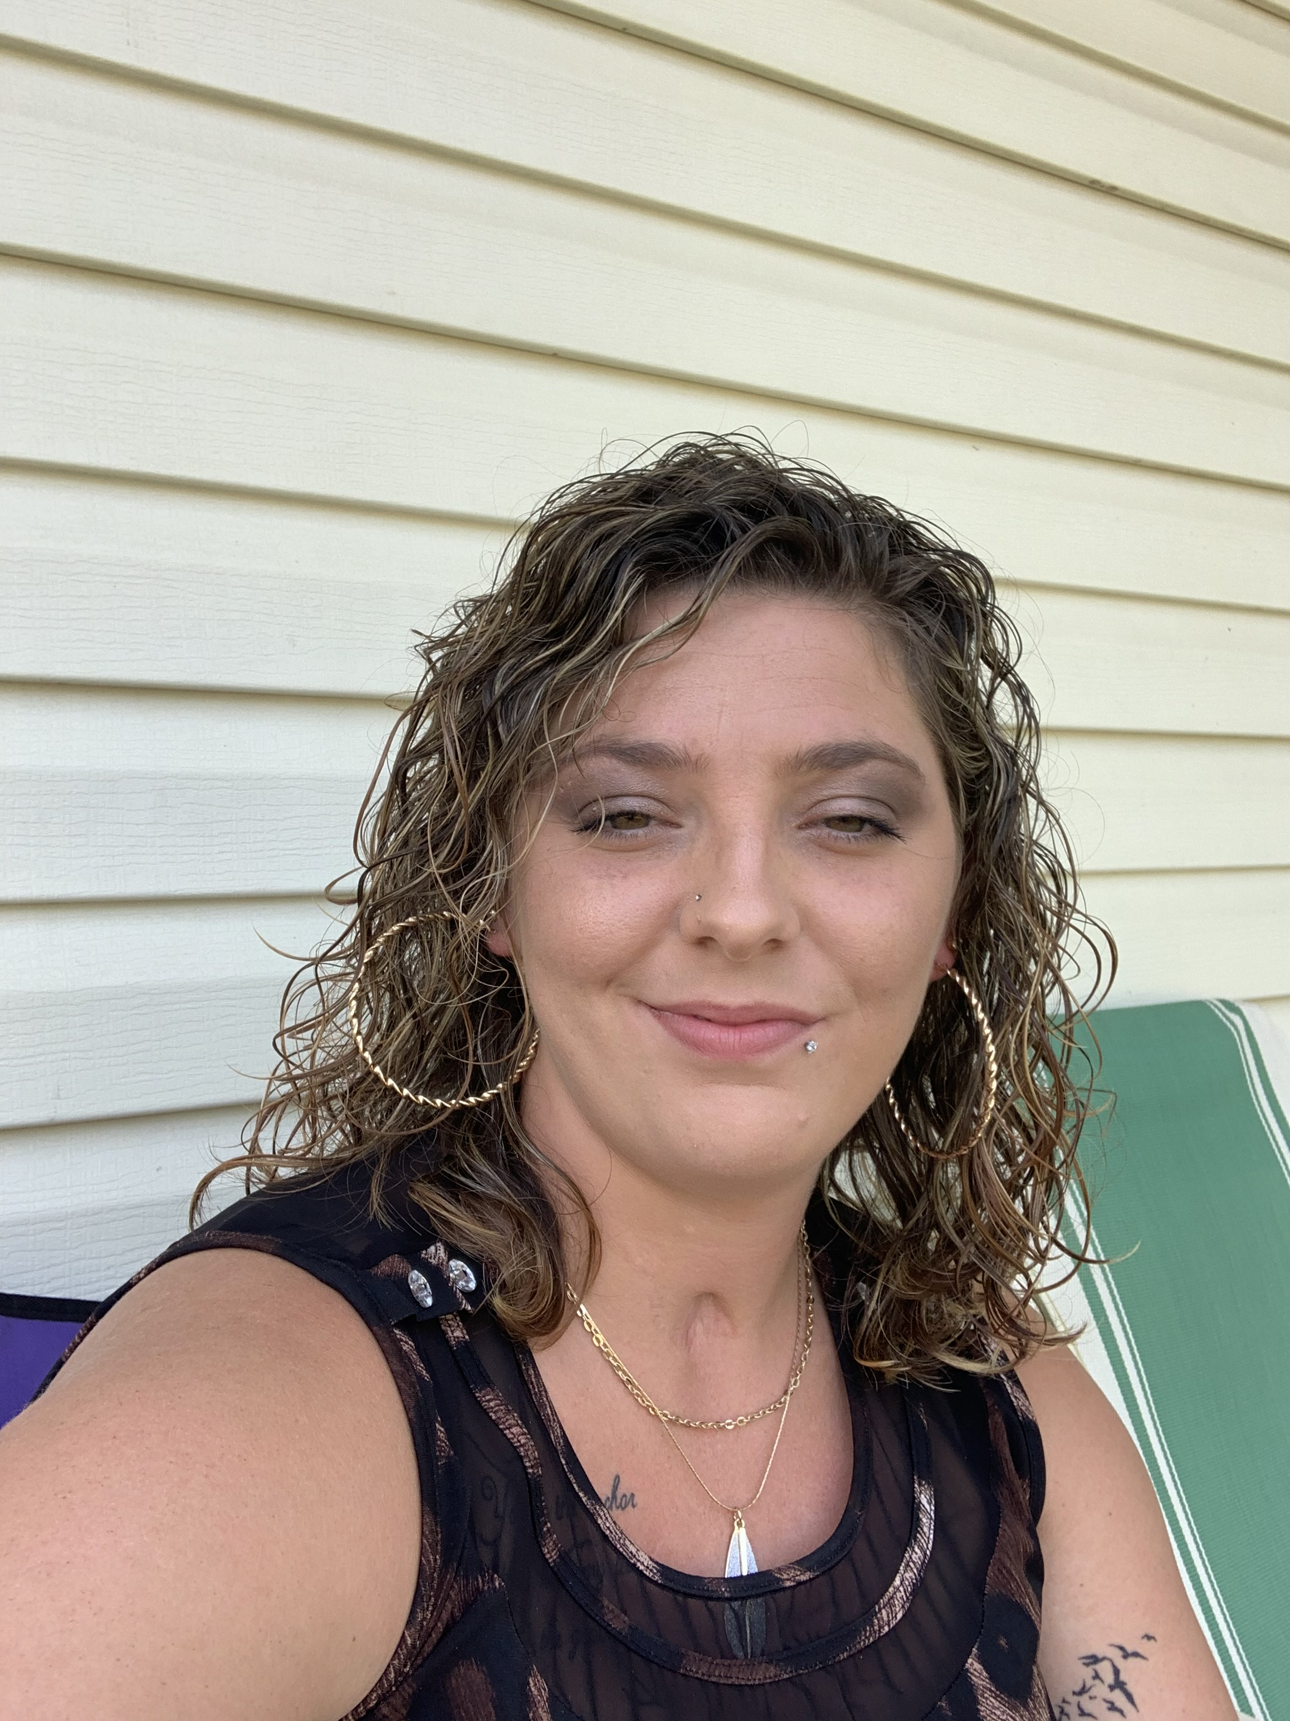
Victoria Harkleroad
Program: Associate of Science Business Administration (BUS.S.AS)
Victoria plans to continue to grow and elevate both of her successful businesses.
Motto: Always make my client’s house feel like their home

Slide 35
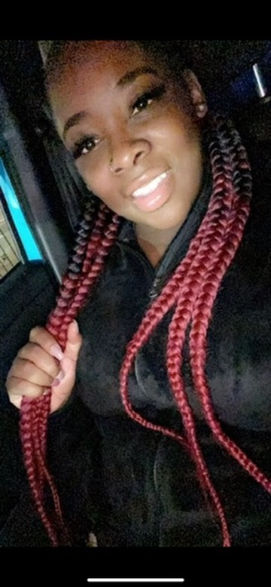
Angel Green
Program: Associate of Arts Elementary Education (ELEE.S.AA)
Angel has worked as a certified preschool teacher for more than five years, and her love for children inspired her to pursue further education.
Favorite quote: My mission in life is not to merely survive, but thrive; and do so with passion, compassion, humor and style.
-Maya Angelo
Motto: Be who you want the world to see you as.

Slide 36
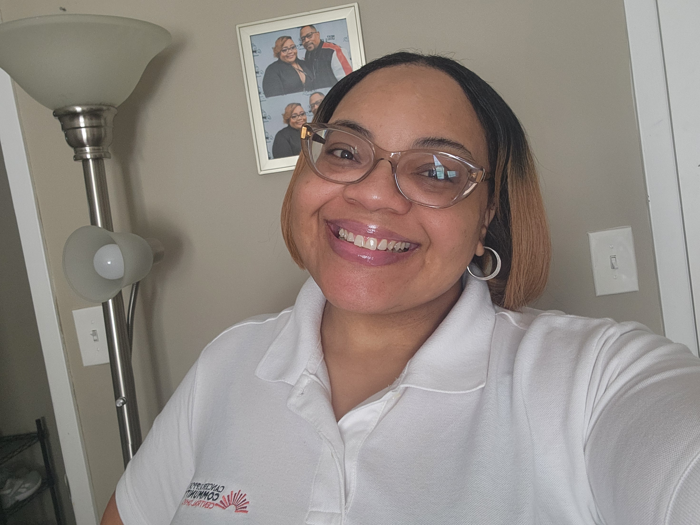
Juanetta Burch
Program: Associate of Arts Social Work (SWKE.S.AA)

Slide 37
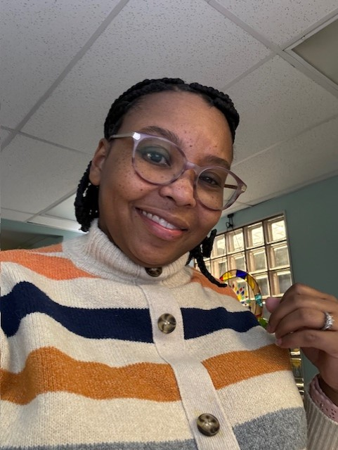
Lashell Pryor
Program: Associate of Applied Science Health Information Management (HIM.S.AAS)
Lashell looks forward to continuing her career with Kettering Health Network.
Favorite quote: 2 Samuel 5:10 "And Lashell went on, and grew great, and the Lord God of hosts was with her.”
Motto: No one achieves greatness on their own.

Slide 38
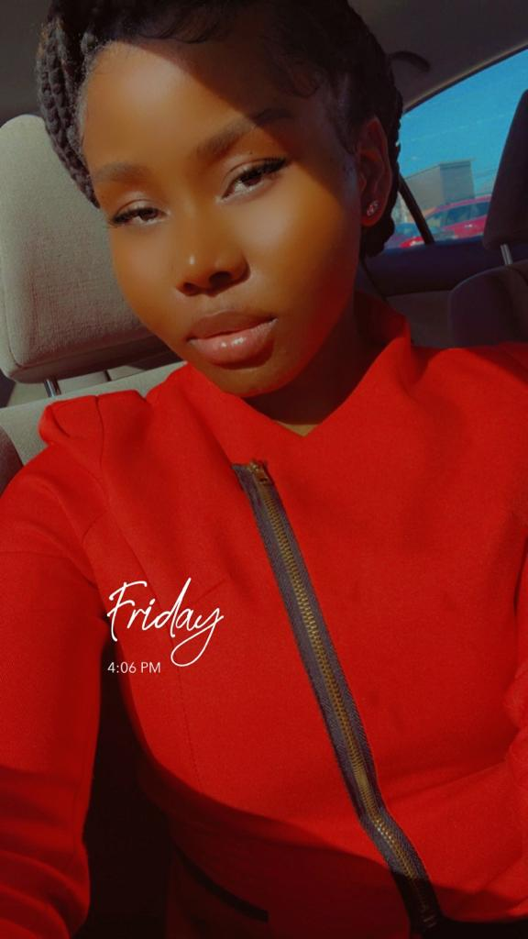
Aimee emmanuel
Program: Associate of Arts Social Work (SWKE.S.AA)
Favorite quote: “It's never too late to do the right thing.”
Motto: To serve and to advocate, Changing lives one heart at a time.

Slide 39
India White
Program: Associate of Applied Science Business Management/Entrepreneurship (ENTR.S.AAS)
India plans to grow her Food Service company and establish her group home “Empowering Capabilities.”
Favorite quote: Galatians 6:9 "And let us not be weary in well doing: for in due season, we shall reap if we faint not.”
Motto: Anything is possible

Slide 40
Dany Anago
Program: Associate of Applied Science Data Analytics (DATA.S.AAS)
Dany is a wife and proud mom of four. She credits her success to her family, especially her husband.
Favorite quote: “Never give up”
Motto: Tomorrow will be better when one puts their mind to it.

Slide 41
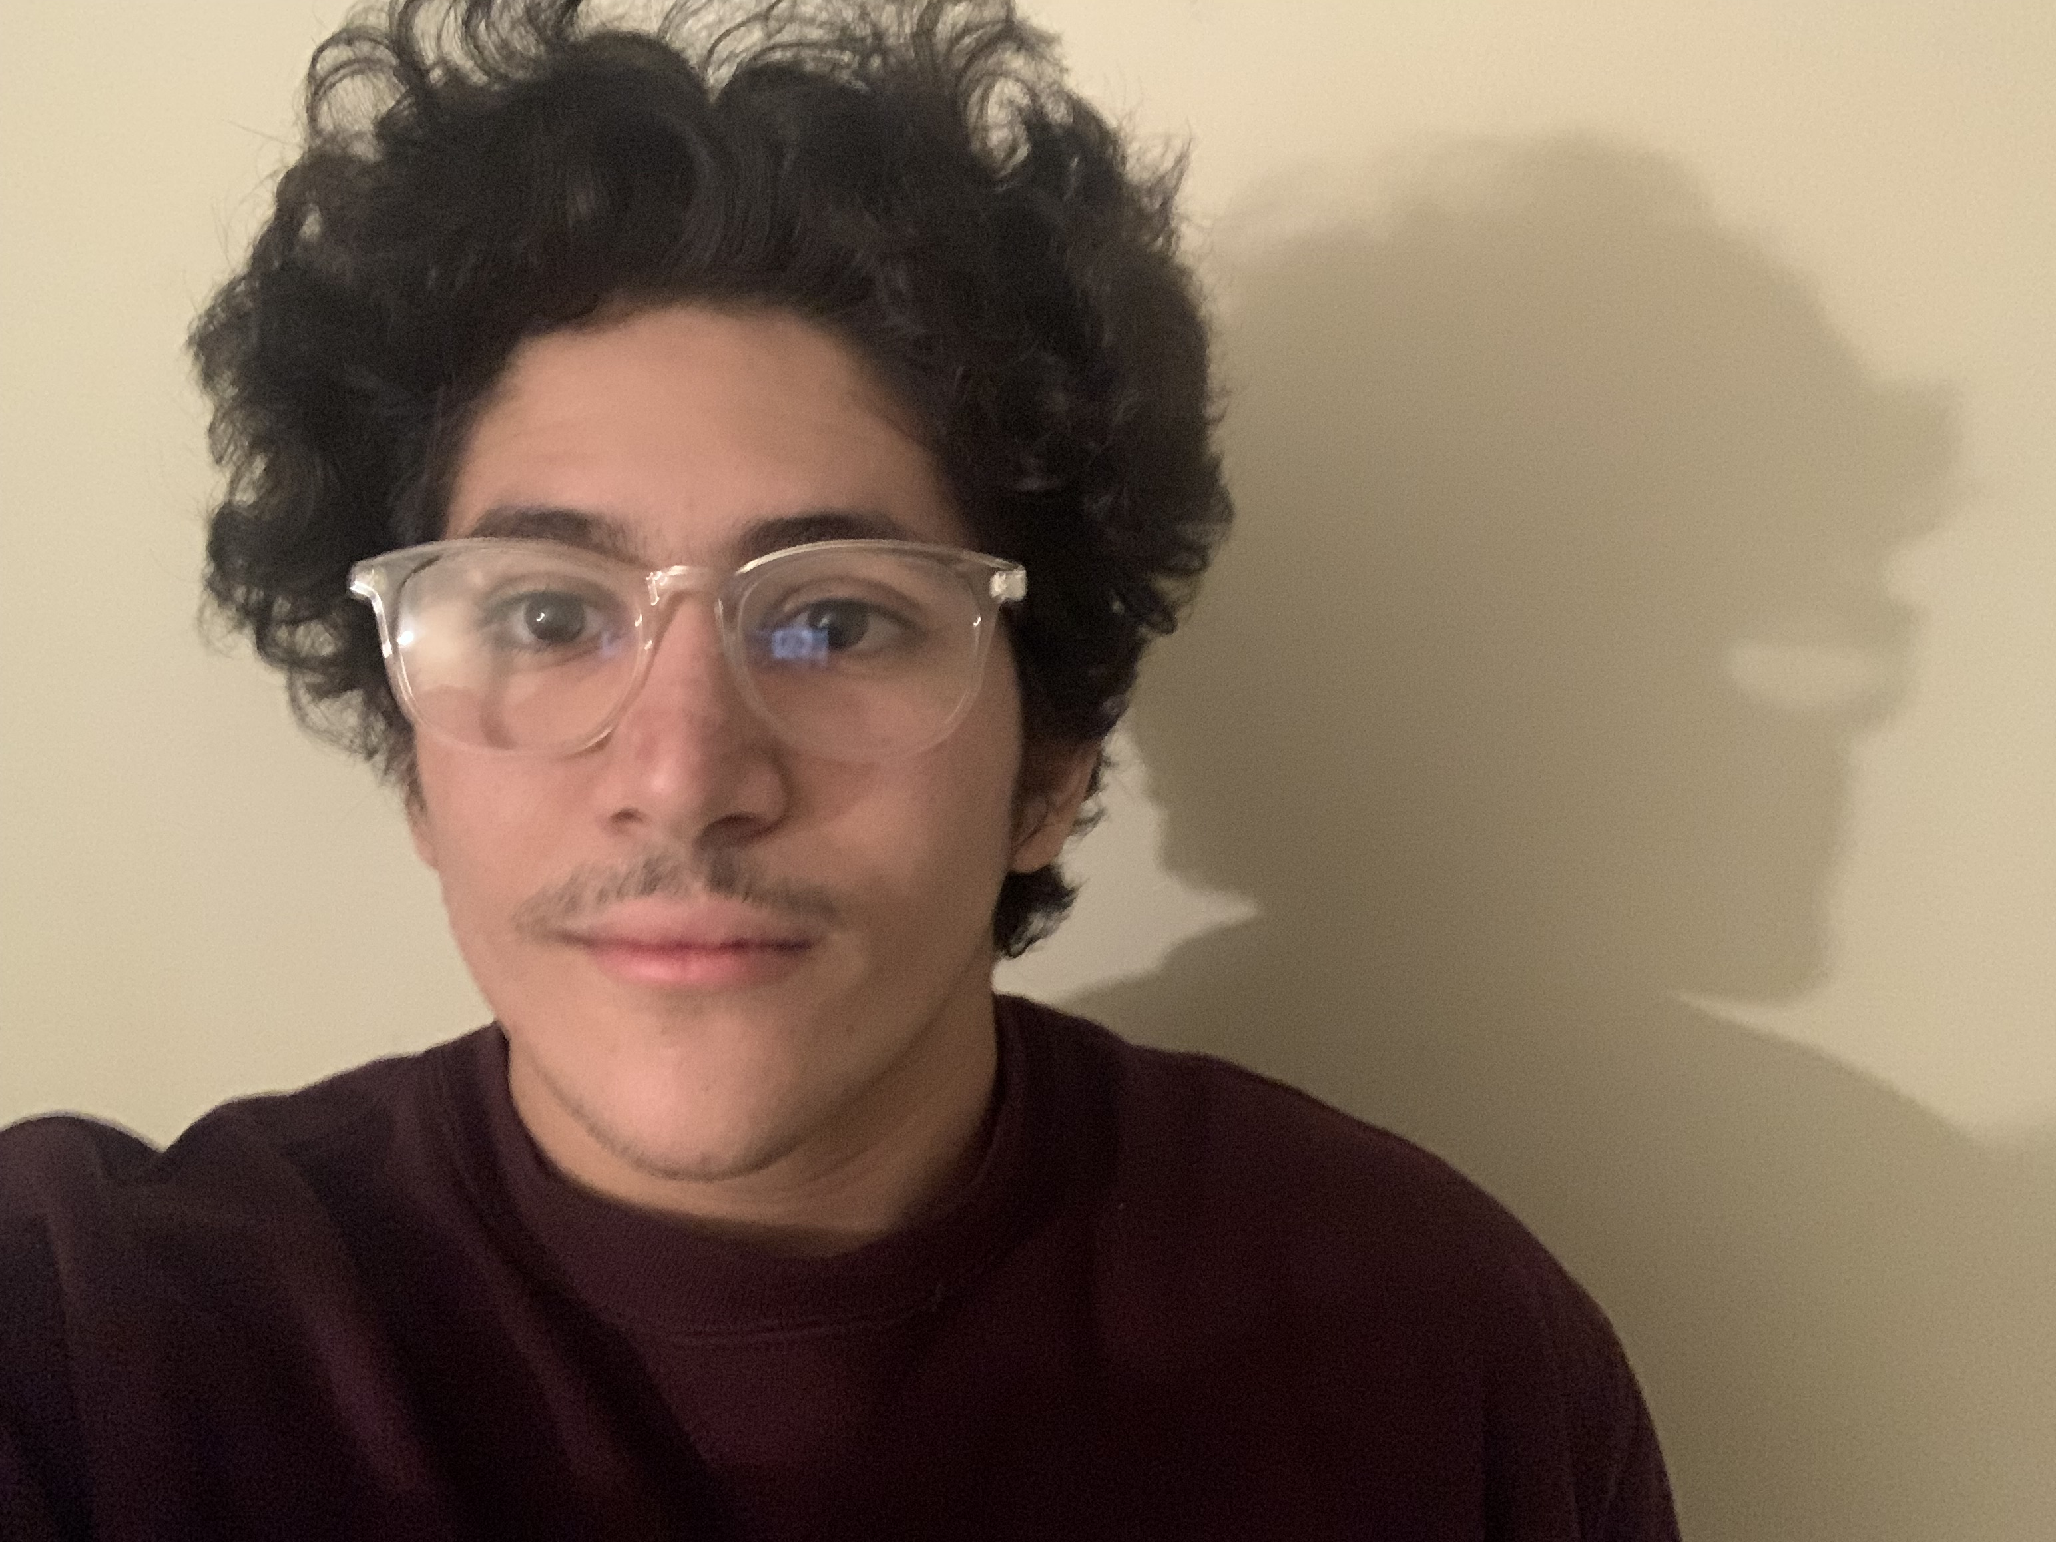
Abdelqadar Radhwan
Program: Associate of Science Biology (BIOE.S.AS)
Abdel plans to eventually go on to Grad school and obtain his Ph.D. in Genetics.
Favorite quote: “The first principle is that you must not fool yourself, you are the easiest person to fool.”
Richard Feynman
Motto: The impediment to action advances action.

Slide 42
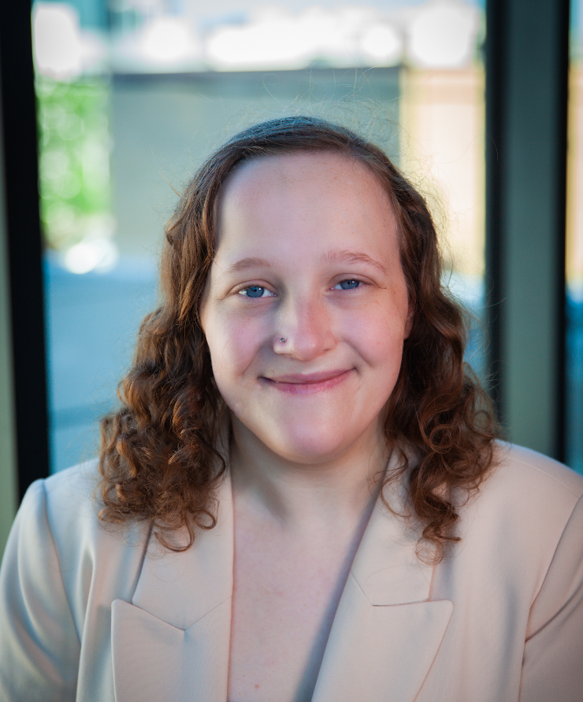
Carly Webster
Program: Associate of Arts Liberal Arts (LA.S.AA)
Carly plans to transfer to Baldwin Wallace University to major in Music.
Favorite quote: “Find something that makes you happy and don’t let anyone take it away from you.”
Luke Hemmings
Motto: Don’t let the insignificance outshine your big wins

Slide 43
Additional Associate degree Earners

Slide 44
Additional Associate Degrees – 2023-24
Toni Bunch
Associate of Applied Science(HS.S.AAS)
Asha Ibrahim
Associate of Science Chemistry (CHEE.S.AS)

Slide 45
Grass to grace award
In memory of Antoinette Hollingsworth
Given to an SSS student who overcame extreme odds to achieve success at SCC

Slide 46
Grass to grace award
This award celebrates your resilience, determination, and the ability to rise above difficult circumstances.
Congratulations Aimee

Slide 47
Congratulations to all!
WE’RE SO PROUD OF YOU!

